Slide 1

Developing a Maze Game

Slide 2
AI in Game Development
We need AI in single-player games to make things more fun!
AI should be sophisticated enough that it can match the player’s skill, but shallow enough to give the player an invisible advantage
Pathfinding AI: a “seeker” enemy who tries to hunt down the player while avoiding all obstacles in the current game level
Behaviour-based AI: acts according to what other entities do

Slide 3
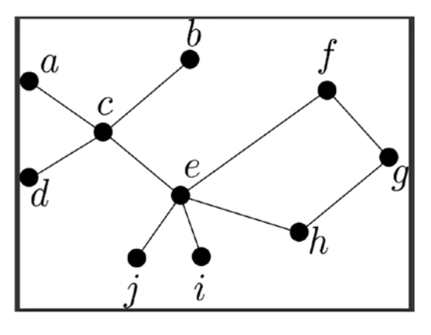
Data structure: graph
A collection of nodes and a collection of edges
A* algorithm: finds a path between two points using graph
Need to convert our game world into a graph
Suppose you have a game world of interconnected rooms…

Slide 4
A* Pathfinding in FXGL
Goal: construct a 2D grid [AStarGrid] that consists of a list of cells [AStarCell], each cell has one of two states: WALKABLE or NOT_WALKABLE
We also want components/physics [CellMoveComponent, AStarMoveComponent] defined on player/enemy, so they can move into a cell if the cell is a room, or stop against a cell if the cell is a wall/obstacle

Slide 5
Behaviour
We will be attaching different components to our AI and let components handle behaviour

Slide 6
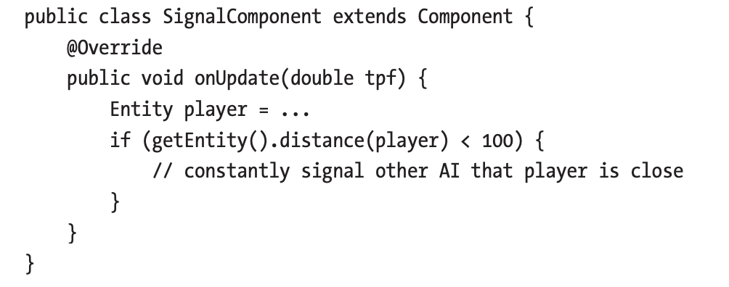
Behaviour
Suppose we want an enemy who is stationary but signals all other AI entities that the player is close

Slide 7
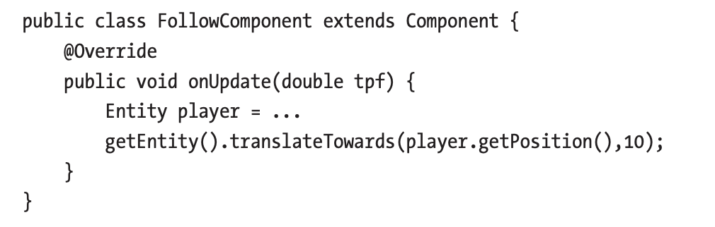
Behaviour
Suppose we want an enemy to always follow, or move in the direction of our player

Slide 8
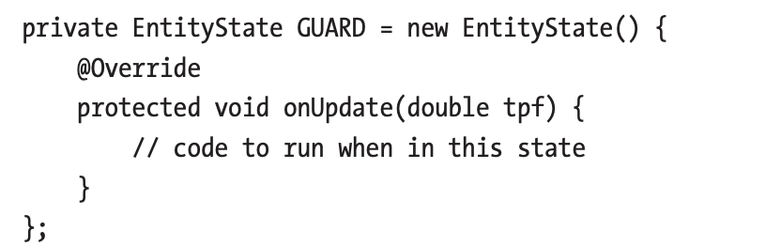
Behaviour
So far, our enemy either always reports on distance away from player, or moves towards player
What if the behaviour is not singular?
We need to decide on the EntityState of our entity, and bind it with StateComponent

Slide 9
Behaviour Example
Goal: build a resource gathering AI such that it automatically moves to any assigned resource to gather it; once its backpack is full, it will attempt to move to the nearest “stockpile” to deposit the gathered resources and clear its backpack
State: gathering, moving, depositing(single action)
Notes:
Pg 122

Slide 10
Pacman
Goal:
have four enemies in a maze-like level filled with coins
Enemy 1: guards a chosen coin
Enemy 2: chases player with a delay
Enemy 3: chases player without a delay
Enemy 4: randomly moves across the game board
Player must traverse the maze and collect coins while avoiding enemies
Time bar
Teleport ability

Slide 11
Creating level map
Map will be stored in a plain text file
1 – block
0 – coin
E – enemy
P - player

